Slide 1

CUSTOMER SEGMENTATION
RFM ANALYSIS
K-MEANS MODELLING
COHORT ANALYSIS
GROUP – 2 CAPSTONE PROJECT - 1

Slide 2
contents
Group Members
Data Analysis
EDA
RFM Analysis
K-Means Analysis
Cohort Analysis

Slide 3
Groups Members
F3662-Muhsin
F3634-İbrahim
F3642-Mehmet
F3645-Mehmet
F3520-Ufuk
F3563-Yunus

Slide 4
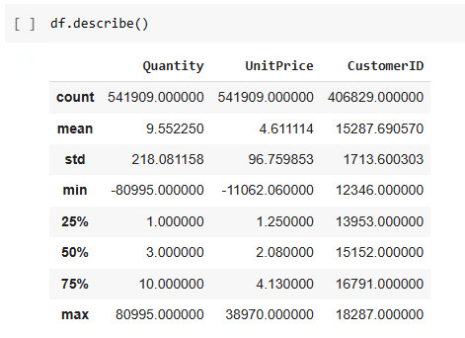
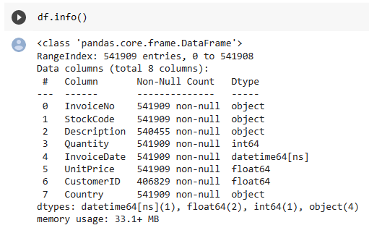
DATA ANALYSIS
Fields : 8
Record : 541909

Slide 5
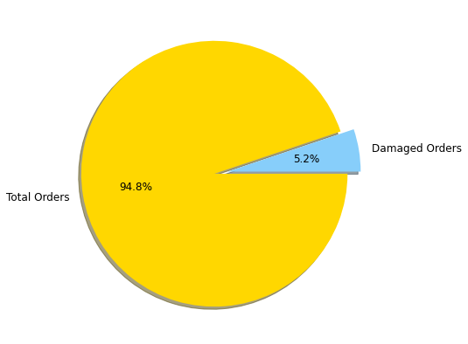
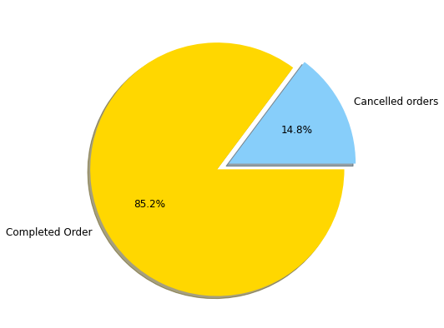
Data analysıs
Total Orders : 25900
Cancelled Orders : 3836
Damaged Orders : 1336

Slide 6
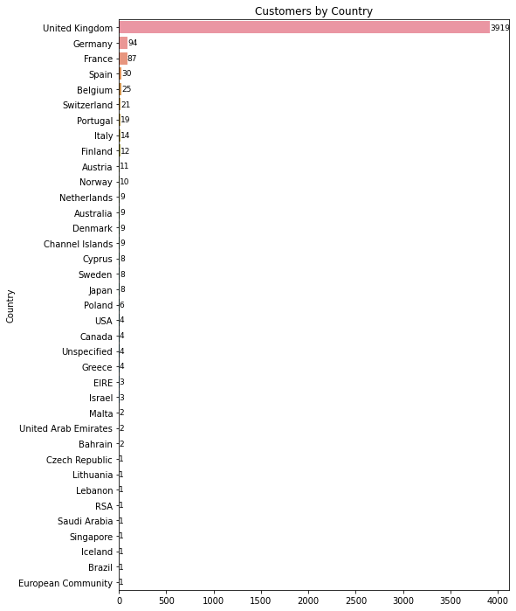
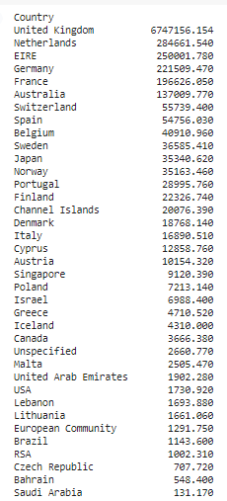
Data analysıs

Slide 7
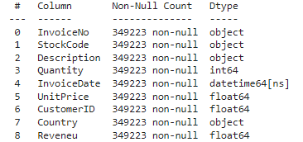
EDA
Dropped Records
Dublicated Records
Cancelled Invoice
Negative Quantities
Negative UnitPrice
Damaged Records
Non-CustomersID
Total Records → 541909
After EDA → 349223

Slide 8
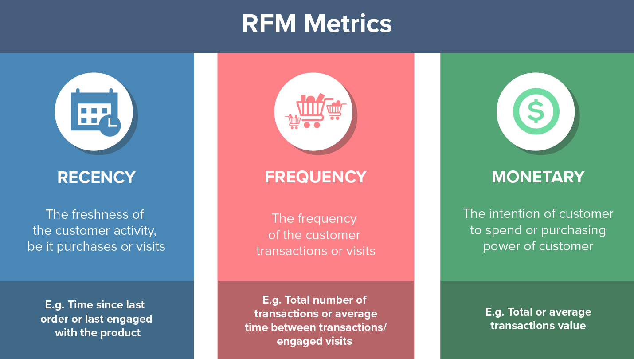
RFM ANALYSIS
https://clevertap.com/blog/rfm-analysis/

Slide 9
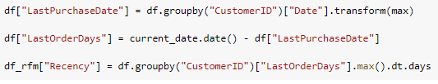
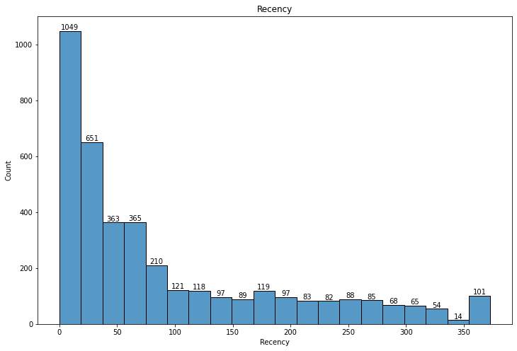
RFM ANALYSIS
Recency

Slide 10
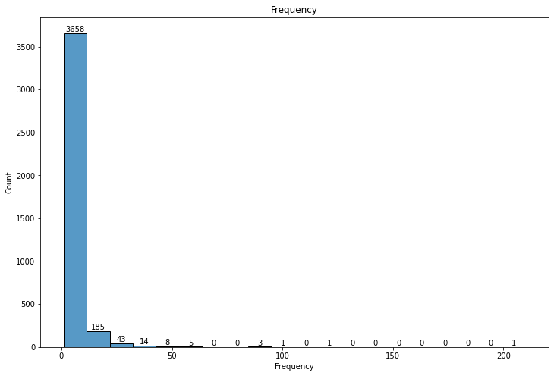
RFM ANALYSIS
Frequency

Slide 11
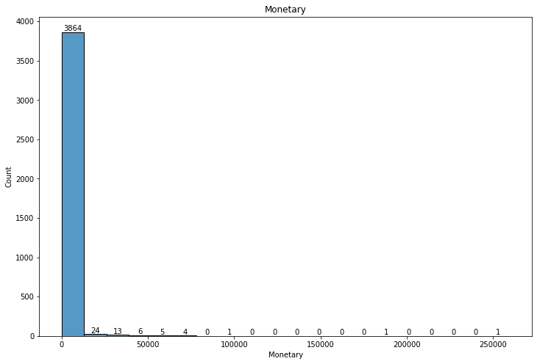
RFM analysıs
Monetary

Slide 12
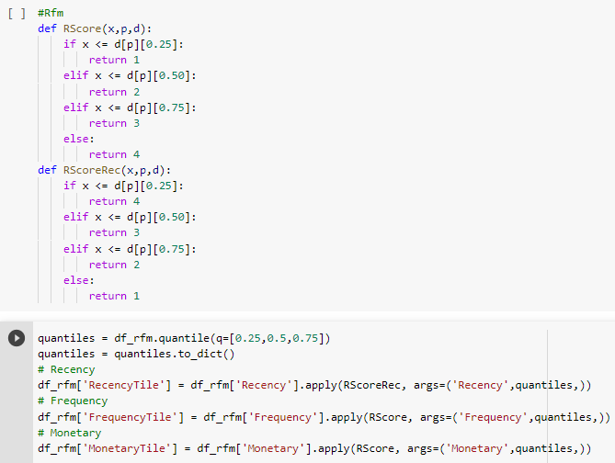
RFM analysıs

Slide 13
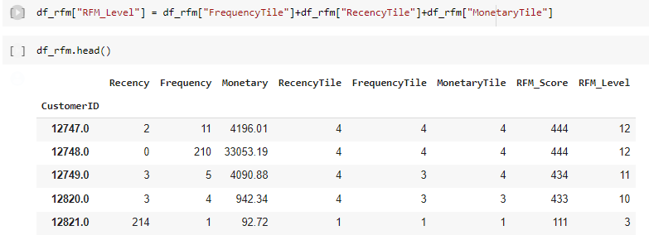
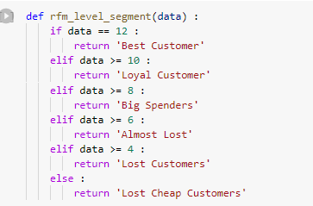
RFM ANALYSIS

Slide 14
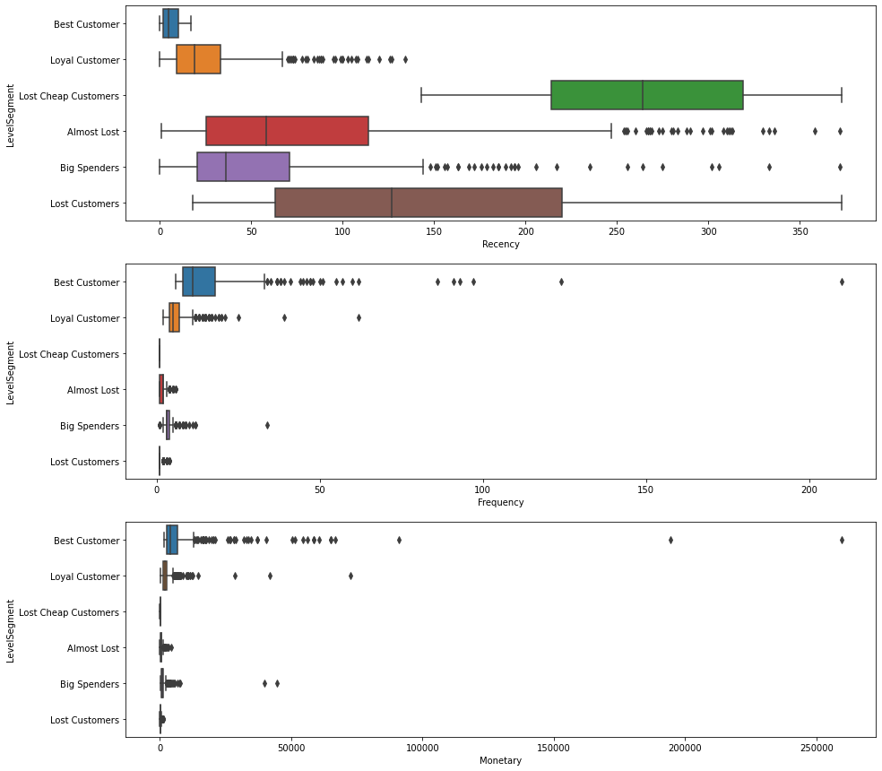
RFM ANALYSIS

Slide 15
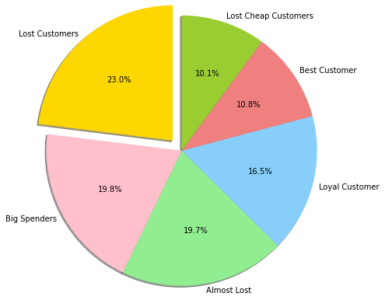
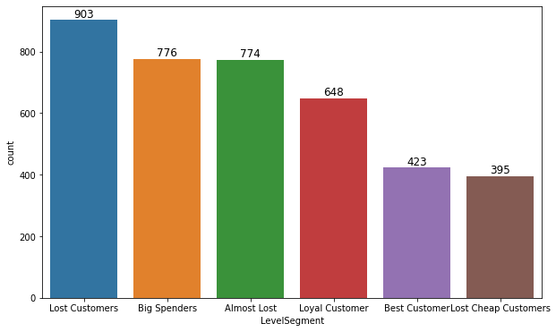
RFM aNALYSIS

Slide 16
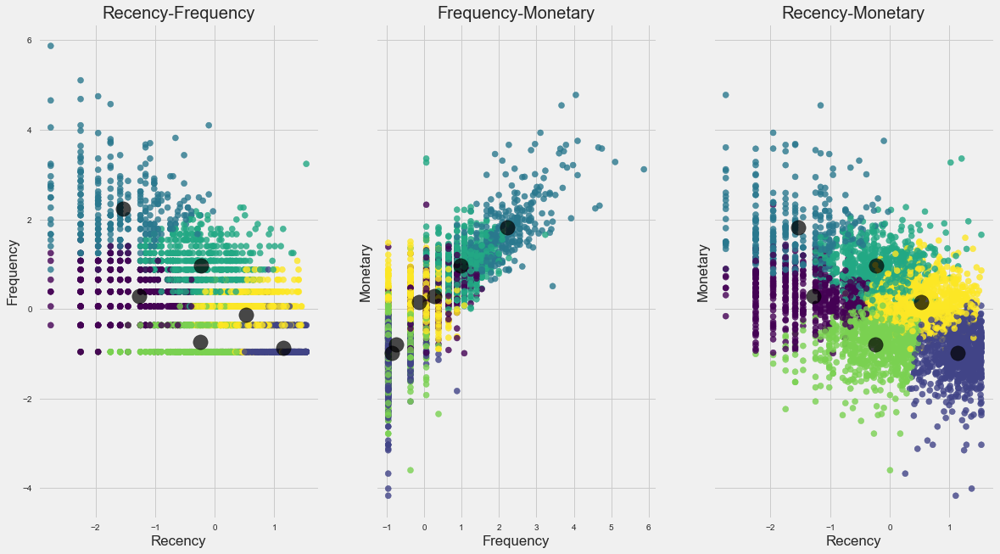
K-MEANS
6 Cluster

Slide 17
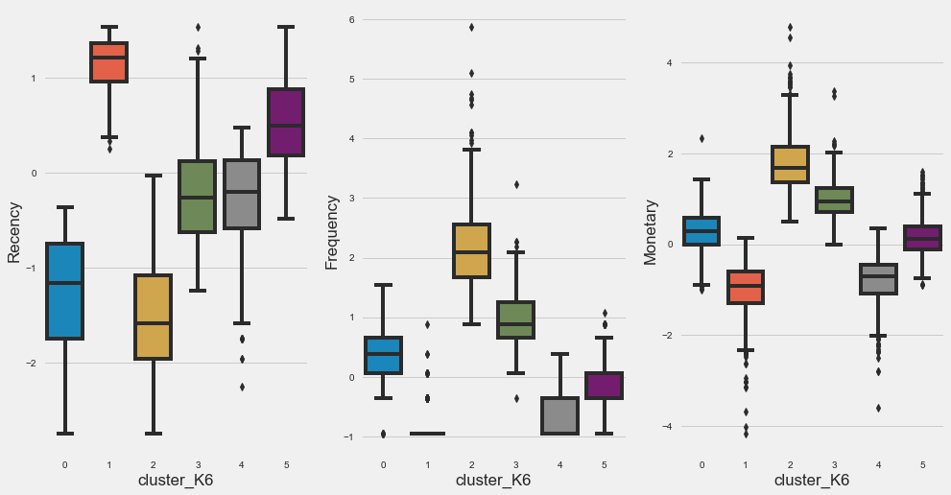
K-Means

Slide 18
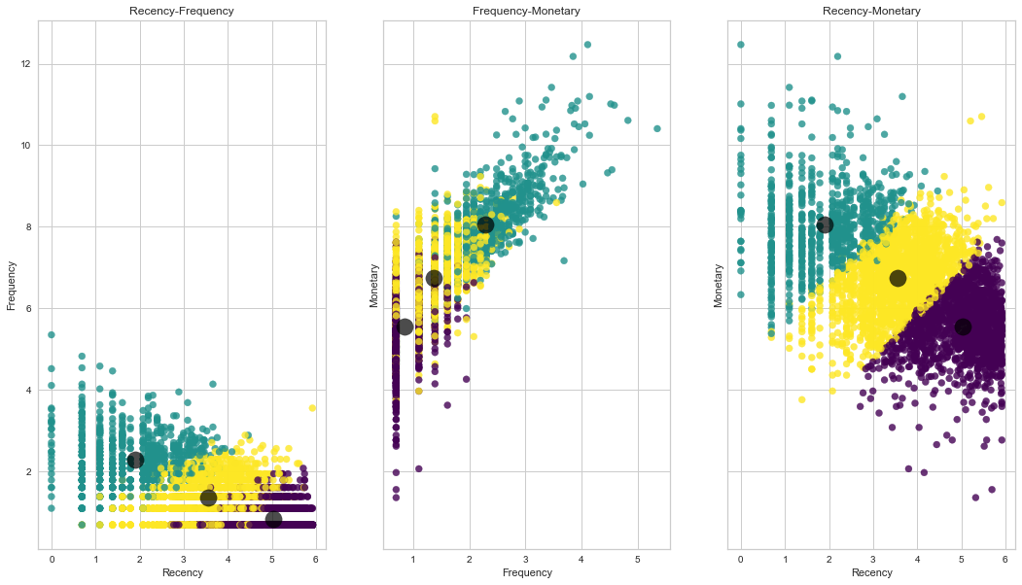
K-MEANS
3 Cluster

Slide 19
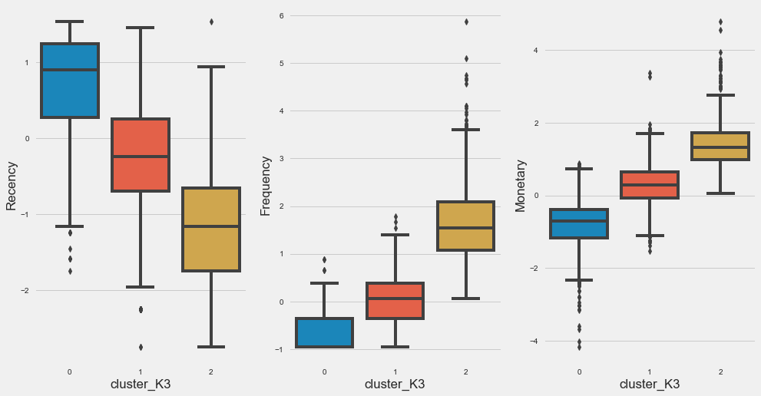
K-Means

Slide 20
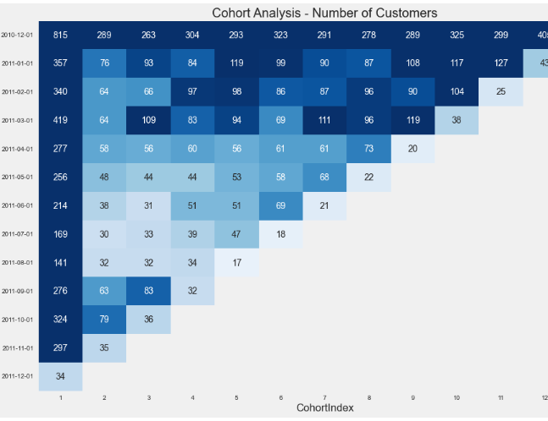
COHORT ANALYSIS
Number of Customers

Slide 21
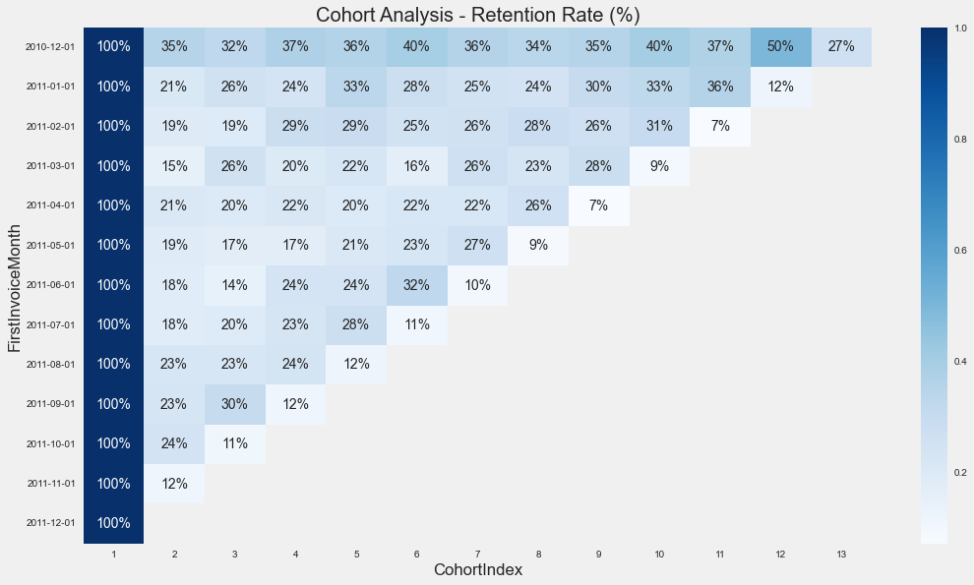
COHORT ANALYSIS
Retation Rate (%)

Slide 22
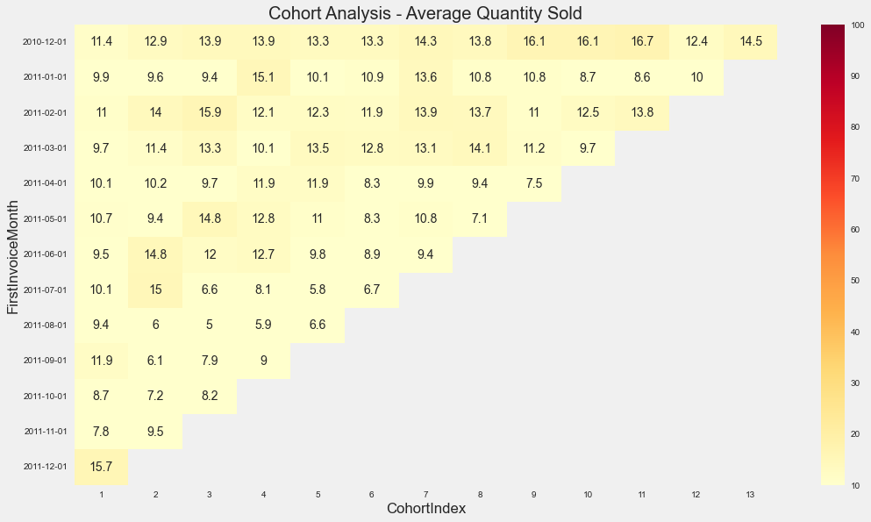
COHORT ANALYSIS
Avarega Quantity Sold

Slide 23
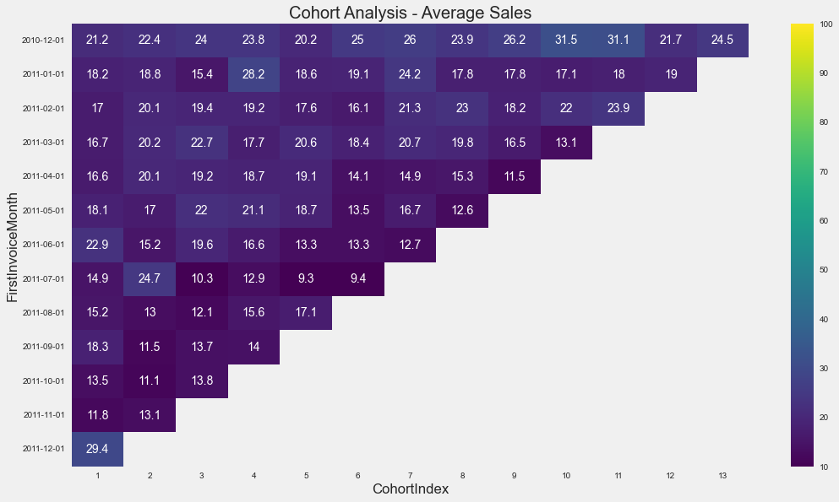
COHORT ANALYSIS
Avarege Sales

Slide 24
TEŞEKKÜRLER

